Slide 1
Software for Embedded Systems
Prof. Saurabh Gandhi (EEE department)

Slide 2
Modeling embedded systems – UML
What do we mean by ‘modeling’ an ES?
What is UML (Unified Modeling Language)?
Why UML for embedded systems?
System context, boundaries and use cases

Slide 3
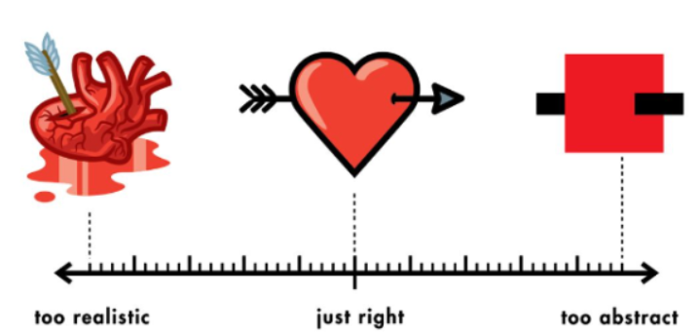

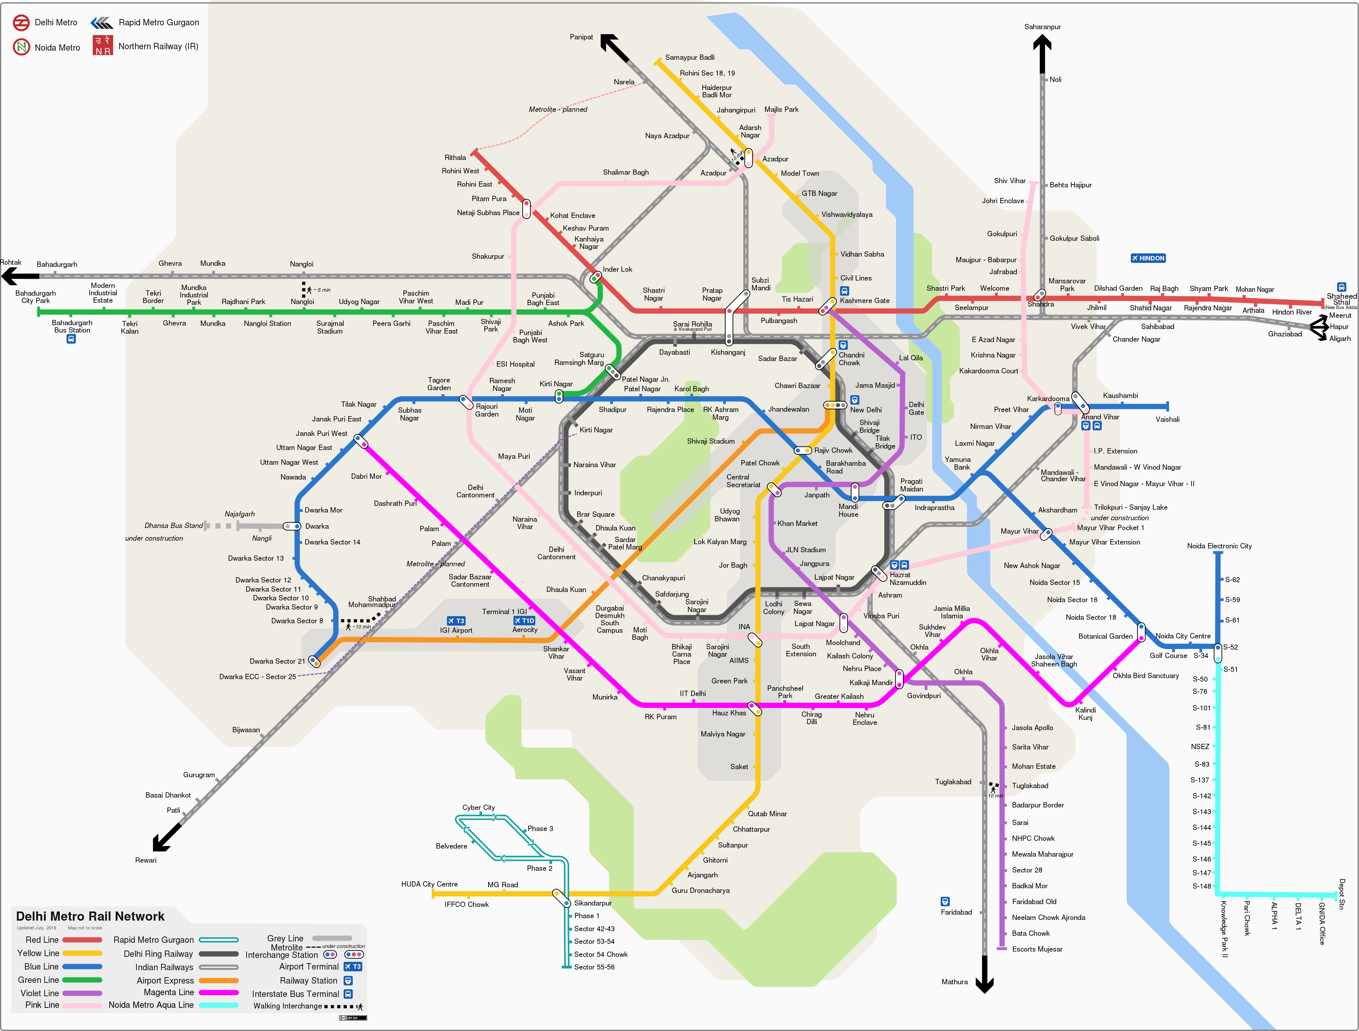
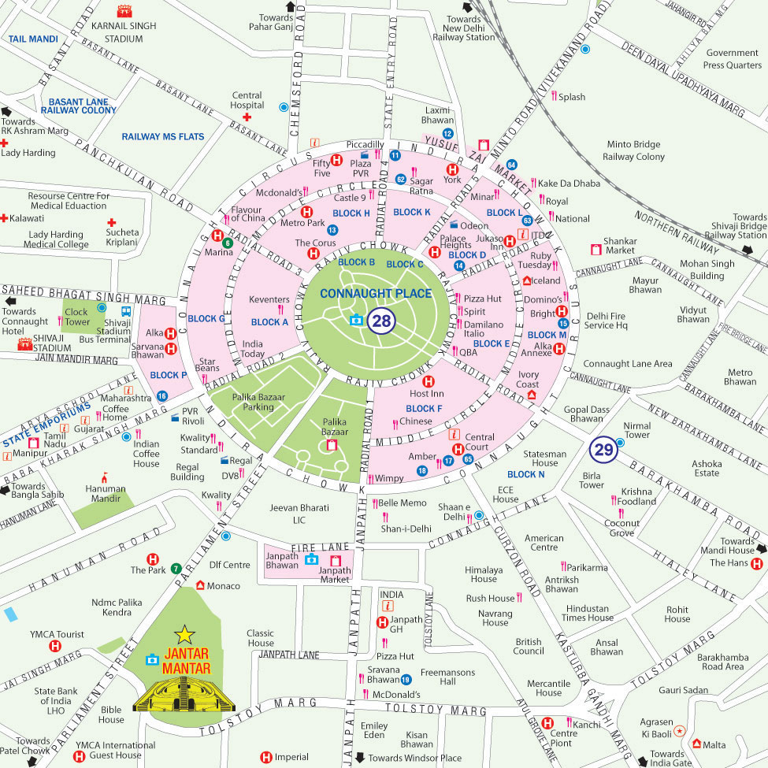

What does it mean to ‘model’ a system?
Models are an abstraction of reality
Partial, imperfect descriptions
What is the use of partial and imperfect descriptions?
Model of the Delhi metro
Which is most accurate?
Which of these is most useful?
Use dependent utility

Slide 4
What is a model?
A model is an abstraction of a physical system. It highlights the essential characteristics while hiding unnecessary implementation details.
The "Blueprint" Analogy:
You wouldn't build a skyscraper without a structural model
You shouldn't build a safety-critical embedded system without a behavioral model
Multiple views of a model
Structural: what the system is made of
Behavioral: How the system reacts to stimuli
Environmental: How the system sits in the real world (what it senses, what it affects, who uses it etc.)
Models help capture assumptions early on!

Slide 5
Why model embedded systems?
Complexity management: Modern embedded systems (e.g., an Autonomous Driving module) have millions of lines of code. Humans cannot hold the entire logic in their heads at once
Early error detection: Finding a logic flaw in a UML diagram costs cents; finding it during "Hardware-in-the-Loop" testing costs thousands; finding it after a product recall costs millions
Communication bridge between H/W and S/W engineers; designers and stakeholders
Basis for simulation: Models can be mathematically verified or simulated to prove certain claims (for example, related to safety)

Slide 6
Without models
System boundaries drift (who handles a sensor fault? Not defined, and no one does it…)
Responsibilities are unclear (both the control task and interrupt try to stop a motor, causing race conditions)
Assumptions remain implicit (Siemens PLC example)
Interfaces are poorly defined (sensor driver reports raw values and control module assumes another unit)
Event handling is incomplete (over-temperature event is handled, but recovery is undefined)
Fault cases are forgotten (normal infusion works perfectly, but behavior after watchdog timer reset is never defined)
Verification becomes ad hoc
Changes break unrelated behavior (adding a new power mode disables alarms because wake-up assumptions were not modeled)

Slide 7
The Unified Modeling Language (UML)
A standardized, graphical language for visualizing system architecture (structure, behavior and environment)
Specifically for embedded systems: SysML (a subset of UML that focuses on real-time constraints and hardware interfaces)
The three pillars of UML:
Things (players involved in the system)
Relationships (associations / dependencies between them)
Diagrams (snapshots of the model from different angles)

Slide 8
System context: The first modeling question
What is the system, and what is not the system?
System boundary defines what is inside and what is outside your system
Whatever falls outside the boundary is an assumption
Whatever falls inside is a specification to be designed and verified

Slide 9
System boundary: Infusion pump example
Nurse? Motor driver?
Stepper motor?
Why outside: software responsibility is to send pulses. If motor jams, not software responsibility
Why inside: They system’s purpose is not to calculate motor angle and send it; purpose is to deliver right amount of drug
No correct answer, but important to agree on an answer! Otherwise…
Control logic will assume motor is behaving as expected
Motor jams are not detected as faults
Software not designed to handle motor faults
What about the temperature sensor?

Slide 10
Actors – who or what interacts with the system?
Anything external that interacts with the system
Human users
External ‘hardware’ (sensors, objects etc.)
…air bubble?
External systems (cloud server)
Actors are determined by the system boundary (for example if sensors are inside the system, they are not actors)

Slide 11
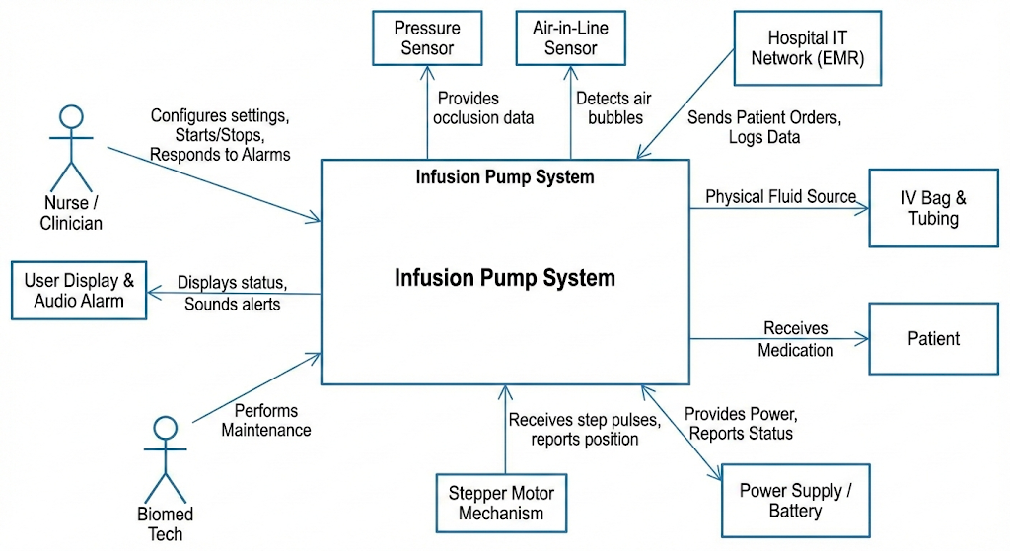
External interfaces
How actors influence the system
Physical interfaces: GPIO pins, communication protocols (SPI, I2C, UART etc.)
Logical interfaces: APIs, protocols (MQTT, HTTP)
The context diagram: high level view showing the system at the center and all actors connected via interfaces

Slide 12
Use Cases: meaningful interactions between actors and system
Use case describes a goal-oriented interaction between an actor and the system
Describe behavior, not interface design!
Behavioral contract: what the system must do in response to a stimulus (not about how it does it)
Example:
User clicks ‘stop’ and screen turns red (WRONG)
System shall transition to a safe state within 10 ms of receiving the ‘stop’ signal from user (CORRECT)
Use case defines
Actor
Trigger
Main success scenario
Alternatives / exception scenarios (fault recovery behavior)

Slide 13
Use cases – infusion pump example
Example use case: deliver drug at programmed infusion rate safely
Who are the actors for this use case?
Nurse (primary), power source, sensors, motor…
What is the trigger?
Nurse programs an infusion rate and starts infusion
Main success scenario:
System accepts programmed infusion rate
System starts pump motor
System continuously regulates flow
System monitors safety during infusion (detects occlusions or over-temperature)
System completes infusion and stops motor
Alternate scenarios:
Over temperature detected: system stops motor and raises alarm
Occlusion detected…
Sensor failure detected…

Slide 14
Use cases and requirements in the V-Model
One use case → many requirements
One requirement → supports multiple use cases
Sit near top-left of V-Model
Help define system tests and acceptance criteria

Slide 15
Summary
UML is a reasoning language
System boundaries define responsibility
Actors are external to the system
Use cases describe behavioral contracts, not UI flows
Correct context modeling prevents downstream errors

Slide 16
Behavioral modeling with UML statecharts
Embedded systems are event-driven
Statecharts allow reasoning about system behavior as a whole
Ensures for every state and input there is a unique, well-defined outcome
Prove system cannot enter into a deadly / undefined state

Slide 17
States, events and transitions
State: represents a specific, finite condition or mode in an object's lifecycle, where it exhibits consistent behavior in response to events
Event: a significant occurrence, stimulus, or message that triggers a transition from one state to another
Interrupt driven (triggered by external actors)
Time-triggered
Transition: change from one state to another driven by an event

Slide 18
States and events in the infusion pump
States
Idle
Infusing
Fault
Events
Sensor threshold crossed
Button pressed
Control loop timer expired
Watchdog timed out

Slide 19
Actions – Entry, Exit and Do
Entry action: executed immediately upon entering a state
Exit action: executed just before leaving a state
Do activity: ongoing activity during the state
Example:
Enter ‘infusing’ state: start motor
Exit ‘infusing’ state: stop motor
Promotes encapsulation: initialization, main logic and clean-up bundled together so easy to understand / debug / maintain
Prevents subtle bugs caused by repeated or missed actions

Slide 20
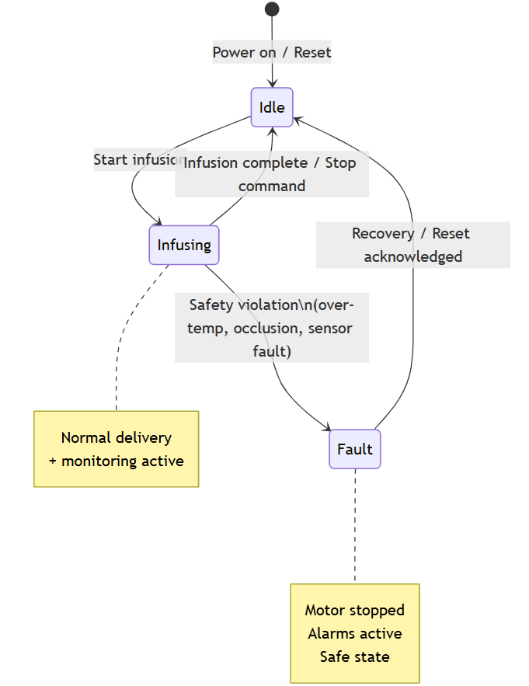
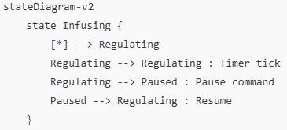
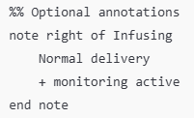
Example state chart for the infusion pump
Making statecharts with Mermaid
Text-based way to create diagrams
Easy version control
Works directly in markdown files (on GitHub, VSCode with the ‘mermaid preview’ extension)

Slide 21
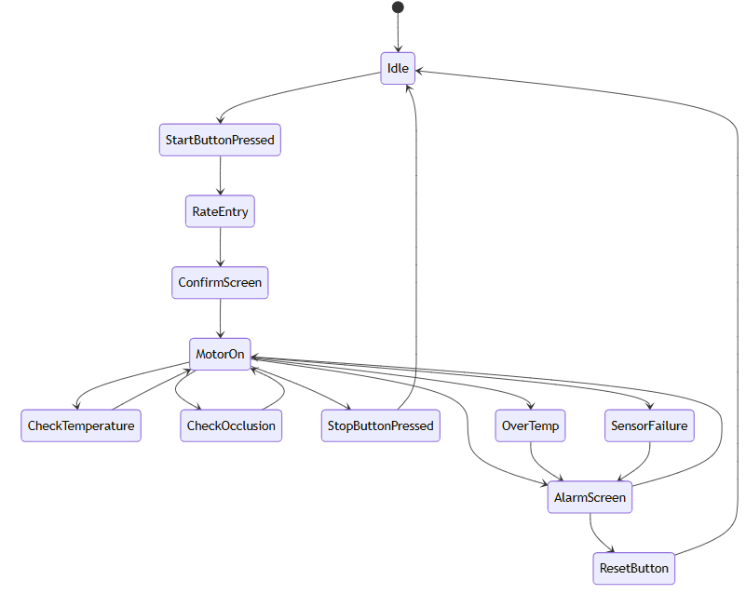
The good and the bad state chart

Slide 22
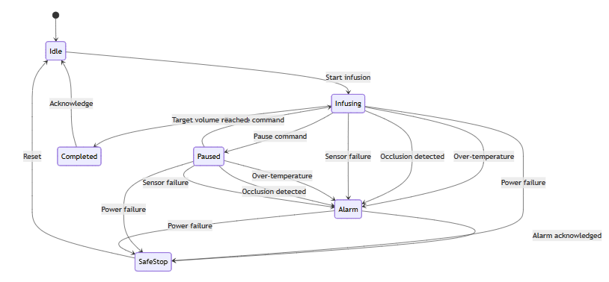
The good and the bad state chart

Slide 23
What is wrong with the second example?
Do we need the extra states?
Every event is repeat for the ‘infusing’ and ‘paused’ state
Every new operational state multiplies transitions
Conceptual duplication: infusing / paused → alarm (over temperature) is conceptually the same thing, but not captured by the diagram
Safety is scattered (no single place that says “while infusing, safety monitoring is always active”)
Too complex looking
Is ‘paused’ a fundamentally different state, or a refinement of ‘infusing’?

Slide 24
Hierarchical states
State Explosion: A complex system can easily have 50+ states, making the diagram unreadable.
Solution: super-states and sub-states
A system can be in an OPERATIONAL super-state, which contains sub-states like SENSING and PROCESSING
Inheritance: events attached to super-state automatically apply to all sub-states

Slide 25
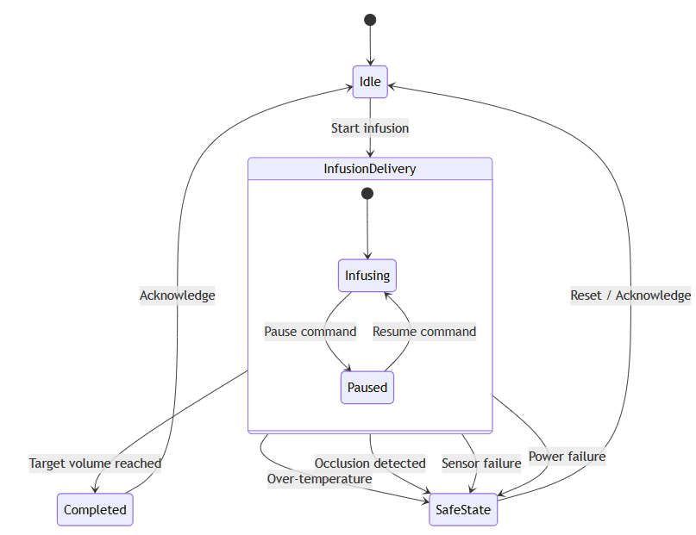
The hierarchical infusion pump statechart

Slide 26
Concurrent / parallel / orthogonal states
An embedded system might be doing multiple functions in parallel (multiple subsystems)
Infusion control
Alarm monitoring
Communication
Statecharts allow concurrent regions
How to show synchronized behavior (for example via shared variables or internal events)?

Slide 27
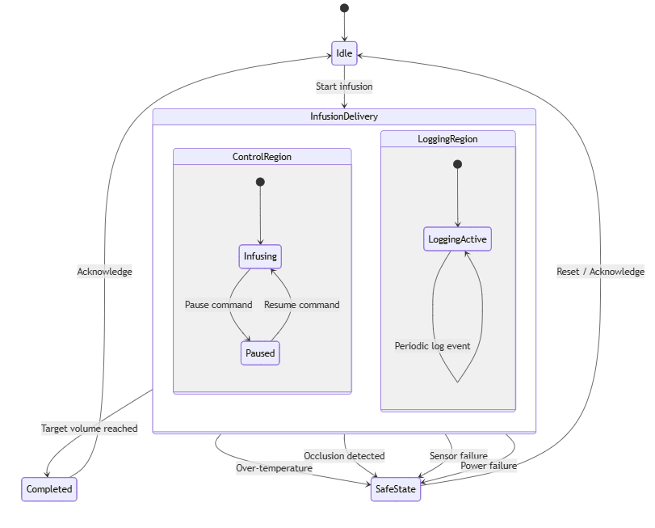
Infusing and logging in the infusion pump
Should logging be a concurrent state inside infusion, or separate altogether?
Might want logging to change behavior in safestate, so use a different logging substate there
Are we implementing two tasks / parallel code?
Only behavioral independence, not implementation

Slide 28
Errors and fault states
Error: recoverable abnormal condition; fault: unrecoverable / safety-critical condition
Happy path modeling is only 20% of the work, rest is fault management; explicitly model error detection and transition to safe states
Safe state: predefined state that minimizes risk
Fault states: explicit states used to handle specific failures (ex, sensor disconnected)
Recovery path: Logic required to move from a fault state to an operational state; must be explicitly modeled

Slide 29
Infusion pump safe state, fault state and recovery
Safe state
Motor stopped
Alarms active
No infusion delivered
Fault state example
Event: temperature crosses threshold
Transition: over-temperature state
Entry action: stop pump, sound buzzer
Recovery: transition back to ‘infusing’ or ‘idle’ (design choice) when temperature back to normal

Slide 30
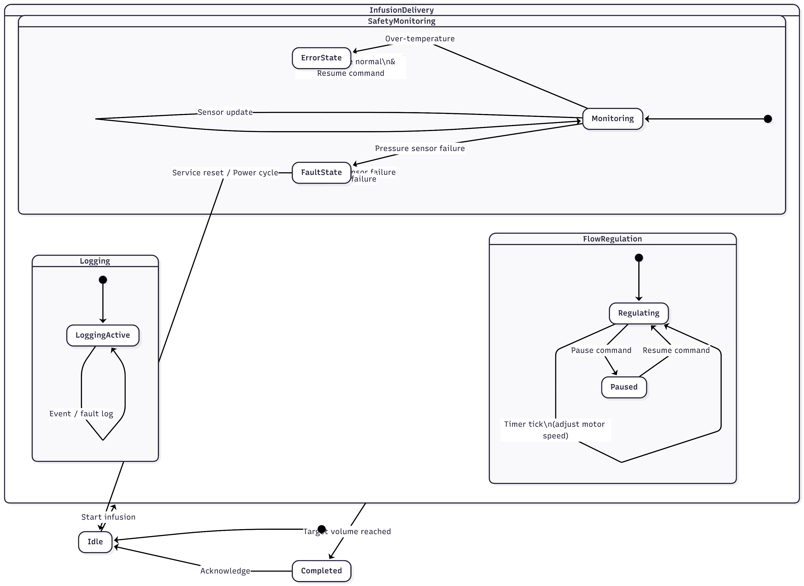
Infusion pump statechart

Slide 31
Interaction modeling and timing awareness
Statecharts tell us the states and transition behavior
How is the transition implemented? Who has to do what and when?
Interaction models explain coordination between actors
The tool: Sequence diagrams

Slide 32
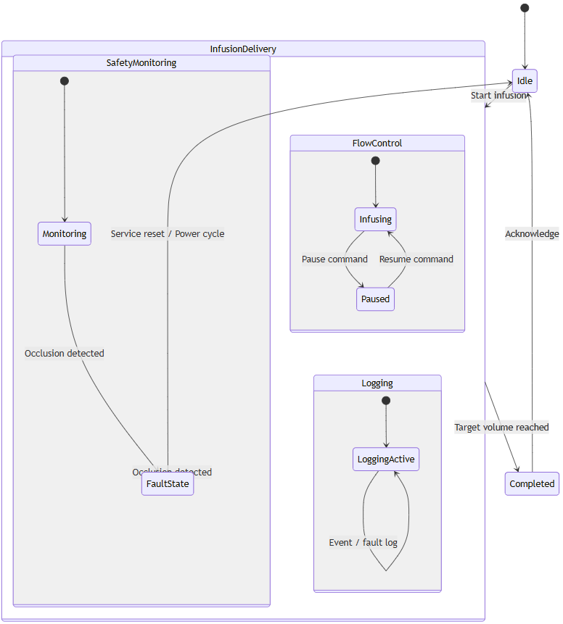
Handling occlusion in the infusion pump
You have designed your occlusion handling system following this behavior
In your test run, you discover that after occlusion is detected, the motor takes variable time to stop between 50 ms to 2 s
This delay is too much!
What could the issue be?
Statechart is not sufficient to explain timing!

Slide 33
What more details do we need?
Statecharts tell us
What state the system enters
Which transitions are valid / occur
They do not tell us
Who detects occlusion
Who notifies it to whom
What might block subsequent execution

Slide 34
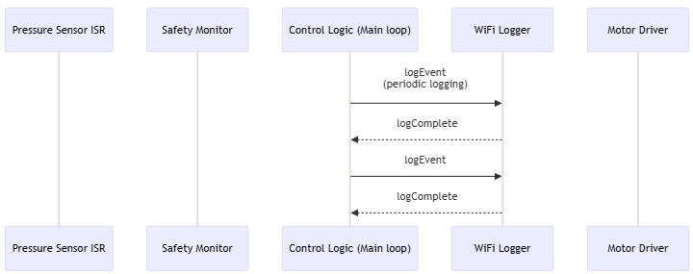
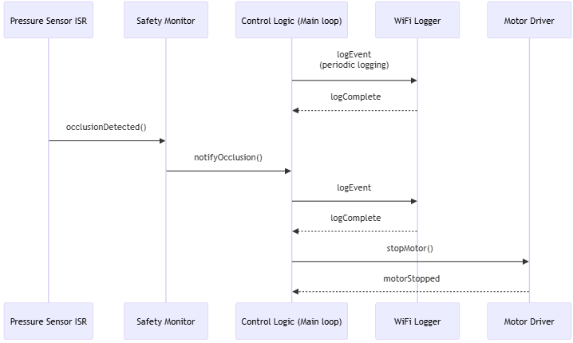
How does the occlusion event actually propagate in the system?
logEvent() is a blocking function i.e. main loop waits till function returns
What could be the reason for variable stopping time?

Slide 35
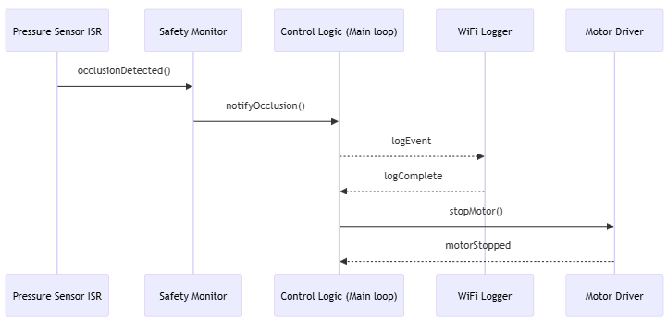
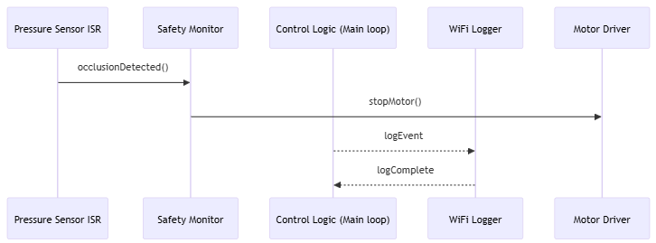
How can this be fixed?
Make logEvent() non-blocking / asynchronous
Let safety monitor directly stop motor
Which is better?
Sequence diagrams might help…

Slide 36
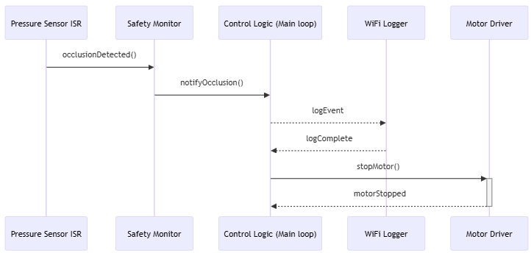
Sequence diagrams
Horizontal axis
Actors / Objects ➡️
Vertical axis
Time ⬇️
Messages (events, commands, notifications)
Solid arrow: Synchronous
Lifeline
(represents a participant)
Dashed arrow: Asynchronous
Activation bar
Active CPU use by task

Slide 37
Synchronous vs asynchronous interactions
Synchronous (blocking): sender waits for response
Function calls
Tightly coupled logic
Affects timing and responsiveness
Asynchronous (non-blocking): sender fires a message and continues its work
Receiver handles message later
Very essential for embedded systems
Interrupts, event queues, message passing

Slide 38
Sync vs async
Aspect | Synchronous | Asynchronous
Blocking | Yes | No
Timing predictability | Local | System-level
Coupling | High | Lower
Typical use | Computation | Events, signaling

Slide 39
Event queues and message passing
External events → interrupts → brief, work is deferred
Event queue: a mailbox where messages wait to be processed
Buffers events
Decouples producer and consumer of events
ISR (producer) pushes event to queue
Control loop (consumer) pops and processes it
Prevents system from being overwhelmed by asynchronous, fast-firing hardware

Slide 40
Infusion pump example
Over-temperature flow:
Sensor detects threshold
Event raised to safety monitor
Safety monitor posts event
Control logic processes event
Motor stop command issued
Logger records fault

Slide 41
Time annotations
What can be deferred? What must happen immediately? What must happen first?
Sequence diagrams can be annotated with
Duration constraints (must happen within 50 ms)
Time observation (marking when an event occurs)
Inter-arrival time (gap between messages)
Nature of event (periodic, must occur immediately etc.)
Builds timing intuition

Slide 42
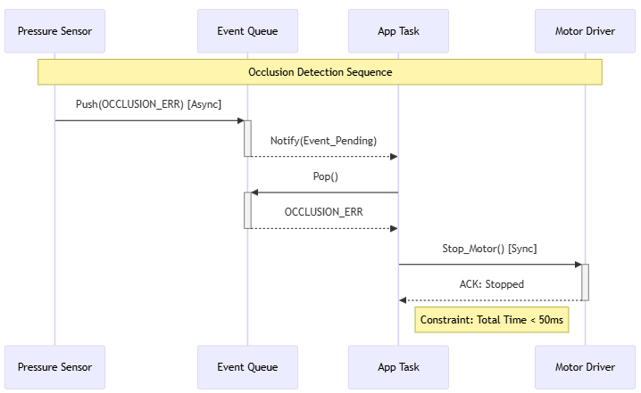
Example

Slide 43
Common pitfalls
Over-modeling: Trying to show every single function call
Only model interactions that cross a boundary (between tasks, between HW and SW etc.)
Ignoring return: forgetting the dashed return arrows that show how one cleans up and returns after handling an event
Clock drift: Assuming asynchronous messages arrive at a particular time

Slide 44
Infusion pump example: what sequence diagrams to include?
System startup and initialization
Reset → boot → initialization
When does logging, monitoring start?
Normal infusion control loop
Periodic flow regulation
Interaction between timer, control logic and motor driver
Safety critical event handling
Error recovery or fault handling
Logging and communication
Interaction with normal operation and error states
Rule of 3: at least 3 lifelines are involved to show complex interactions
Time critical (sequence showing hard deadlines)
Black box (interactions involving external actors that you cannot control)

Slide 45
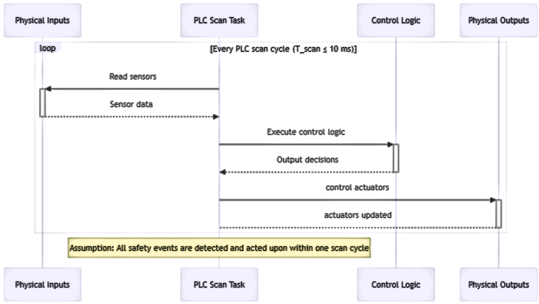
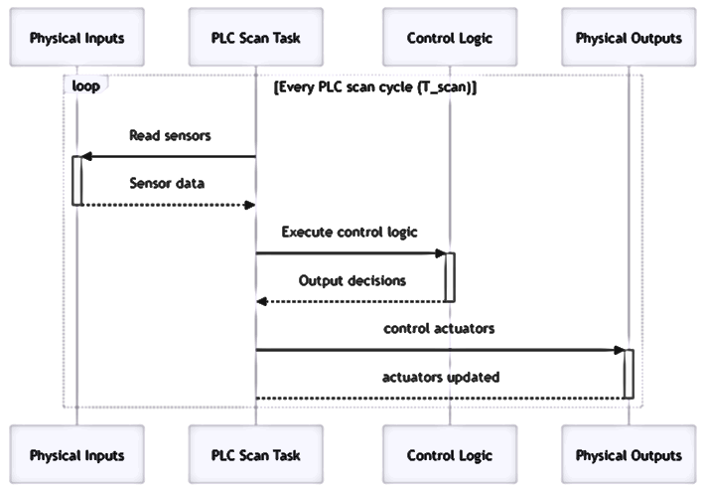
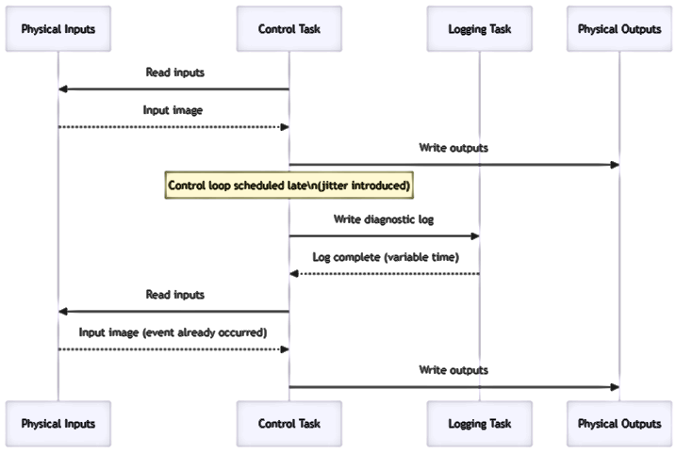
Siemens PLC example

Slide 46
From models to tests

Slide 47
Statecharts → Unit and functional testing
States: Test the system in correct configuration for each state (eg in Alarm state buzzer must be active)
Transitions: Test the logic (eg if pressure > threshold, transition from infusing to fault state)
Infusion pump example:
Infusing → fault (triggered by occlusion event)
Tests: Force system to receive an ‘occlusion’ signal. Then check if:
State is updated to ‘fault’
Motor is stopped
No infusion resumes without reset

Slide 48
Sequence diagrams → Integration tests
Order of messages: verify that task A calls task B before task C
Timing constraints: Verify that response occurs within modeled activation bar duration
Asynchronous paths: Verify that arrows such as ‘callback’ and ‘interrupt’ actually trigger the expected tasks in the final system

Slide 49
Mapping models to tests
Model | Test Type | Example
Statechart | State-transition test | Occlusion → FaultState
Statechart | Illegal transition test | Resume in FaultState
Sequence diagram | Ordering test | Stop before log
Sequence diagram | Blocking test | No waits in safety path
Sequence diagram | Timing test | Bounded response

Slide 50
Best practices
Principle | The Rule | Why?
The 80/20 Rule | Model the 20% of the logic that handles 80% of the safety risks. | You can't model everything; focus on what can kill the patient or brick the device.
Deterministic Transitions | Every event in a state must have exactly one (or zero) valid transitions. | Avoids "Race Conditions" where the system doesn't know which state to enter.
Async by Default | If a task takes >10 ms, model it as an asynchronous sequence. | Prevents the "Blocking Trap"
Shallow Hierarchy | Limit state nesting to 3–4 levels. | Prevents "Stack Overflow" on small MCUs and keeps diagrams readable.
The "Golden" Exit | Put safety-critical hardware shutdowns in Exit Actions. | Ensures hardware is safe even if the software crashes or branches unexpectedly.

Slide 51
ROPES: Rapid Object-oriented Process for Embedded Systems
ROPES defines:
How to decompose an embedded system
How to use UML models responsibly
How to prevent timing, blocking and safety failures

Slide 52
ROPES connect requirements, UML, architecture and tests
Design rules that make interaction assumptions explicit and enforceable
ROPEs prevent:
Blocking in safety paths
Hidden coupling
Timing assumptions living in designers’ heads

Slide 53
ROPES principle #1
Critical paths must not depend on non-critical services
Infusion pump example:
Motor stop must not wait for
Logging
UI updates
Network communication
This rule fixes blocking sequence in critical paths.

Slide 54
ROPES principle #2
Different concerns belong in different partitions
Infusion pump example
Safety monitoring
Control logic
Logging / diagnostics
Partitions
Communicate via explicit events
Do not share hidden states

Slide 55
ROPES principle #3
All cross-partition interactions must be explicit
No shared global variables accessed across partitions
No hidden blocking calls
No implicit ordering of events

Slide 56
ROPES principle #4
Concurrency is designed not discovered
Explicit concurrent behaviors
Explicit synchronization
Explicit priorities
Example: state chart should explicitly show that control, safety monitoring and logging are concurrent

